Slide 1

APPLICATIONS
of
OPEN SOURCE SYSTEM
- A research perspective
Dr. S.Mohideen Badhusha
Professor/CSE,
Alva’s Institute of Engineering and Technology,
Moodbidri, Mijar, Mangalore

Slide 2
Open Source System
Open source software is code that is designed to be publicly accessible—anyone can see, modify, and distribute the code as they see fit.
The history of open source is the history of the internet (1960 since ARPANET)

Slide 3
Free software
Free software movement was formally established by Richard Stallman in 1983 through the GNU Project
The free software movement focuses on freedom to see the source code, to modify it, to redistribute it but not to own it.
Peterson proposed the idea of "open source" to a working group in late 90s
Open Source Software is better as it is collaborative, open and modifiable.

Slide 4
Advantages of Open source software
Peer review
Transparency
Reliability
Flexibility
Lower cost
No vendor lock-in
Open collaboration

Slide 5
Open source Applications
GitHub
Linux
LibreOffice
Mozilla Firefox
Apache web server
VLC Media Player
GIMP
Python
PHP

Slide 6
Advantages for researchers
Ready-to-use Application software
Cutting-edge technology
Cost savings
Faster development

Slide 7
Research Applications
Jupyter Notebooks: A web-based interactive computing platform that combine live code, equations, narrative text, interactive user interfaces
NetworkX: A reference library for network science algorithms in Python. It is used in research applications such as disease spread, cyber security, and measuring scholarly impact
NumPy : A fundamental array module in Python. It is applied in Data science
Pandas : Python package providing fast, flexible, and expressive data structures
Scikit-image : It is a community-driven Python project, consisting of a vast collection of high-quality, peer-reviewed image processing algorithms for researchers at free of charge
SciPy is an open-source scientific computing library for the Python programming language. A collection of scientific algorithms is widely used by researchers across academia and industry,

Slide 8
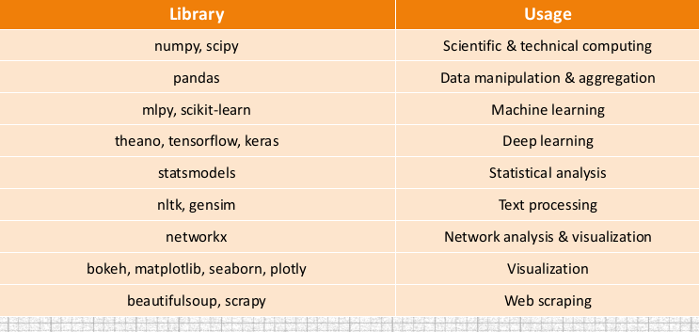
Popular libraries in Python

Slide 9

Concluding Tips
Open source software are immensely useful for research applications
Unfortunately they are rarely being used by the researchers as they reluctant to switch it over to OSS community support
The quality of research will be enhanced and duration of the research will reduced when the open source software are used in research perspective

Slide 10
Demonstration on Applications of modules in Python
Pandas
Numpy
Matplotlib
Beautiful soup
networkx

Slide 11
APPLICATIONS
of
OPEN SOURCE SYSTEM
- A research perspective
DATE : 12.2.22 from 3.00 pm to 4.30 pm
Resource Person :Dr. S.Mohideen Badhusha
Important Note : As it is practical demonstration session conducted through Google colab, the workshop participants are asked to keep their desktop or laptop ready for the hands-on session to work out the exercises.

Slide 12
APPLICATIONS
of
OPEN SOURCE SYSTEM
- A research perspective
DATE : 12.2.22 @ 3.00 pm
Dr. S.Mohideen Badhusha
Professor/CSE,
Alva’s Institute of Engineering and Technology,
Moodbidri, Mijar, Mangalore

